Slide 2
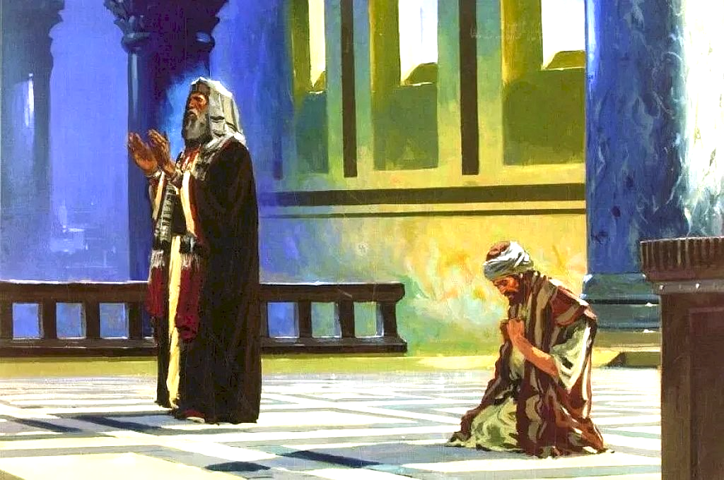
Luke 18:9-14

Slide 3
Matthew 21:31-32
Which of the two did the will of his father?" They said, "The first." Jesus said to them, "Truly I say to you that the tax collectors and prostitutes will get into the kingdom of God before you. For John came to you in the way of righteousness and you did not believe him; but the tax collectors and prostitutes did believe him; and you, seeing this, did not even feel remorse afterward so as to believe him.

Slide 4
Luke 7:28-30
I tell you, among those born of women there is no one greater than John; yet the one who is least in the kingdom of God is greater than he."(All the people, even the tax collectors, when they heard Jesus' words, acknowledged that God's way was right, because they had been baptized by John. But the Pharisees and the experts in the law rejected God's purpose for themselves, because they had not been baptized by John.)

Slide 5
Avoiding the Pitfall of
Self-Righteousness

Slide 6
The Step of “Others”

Slide 7
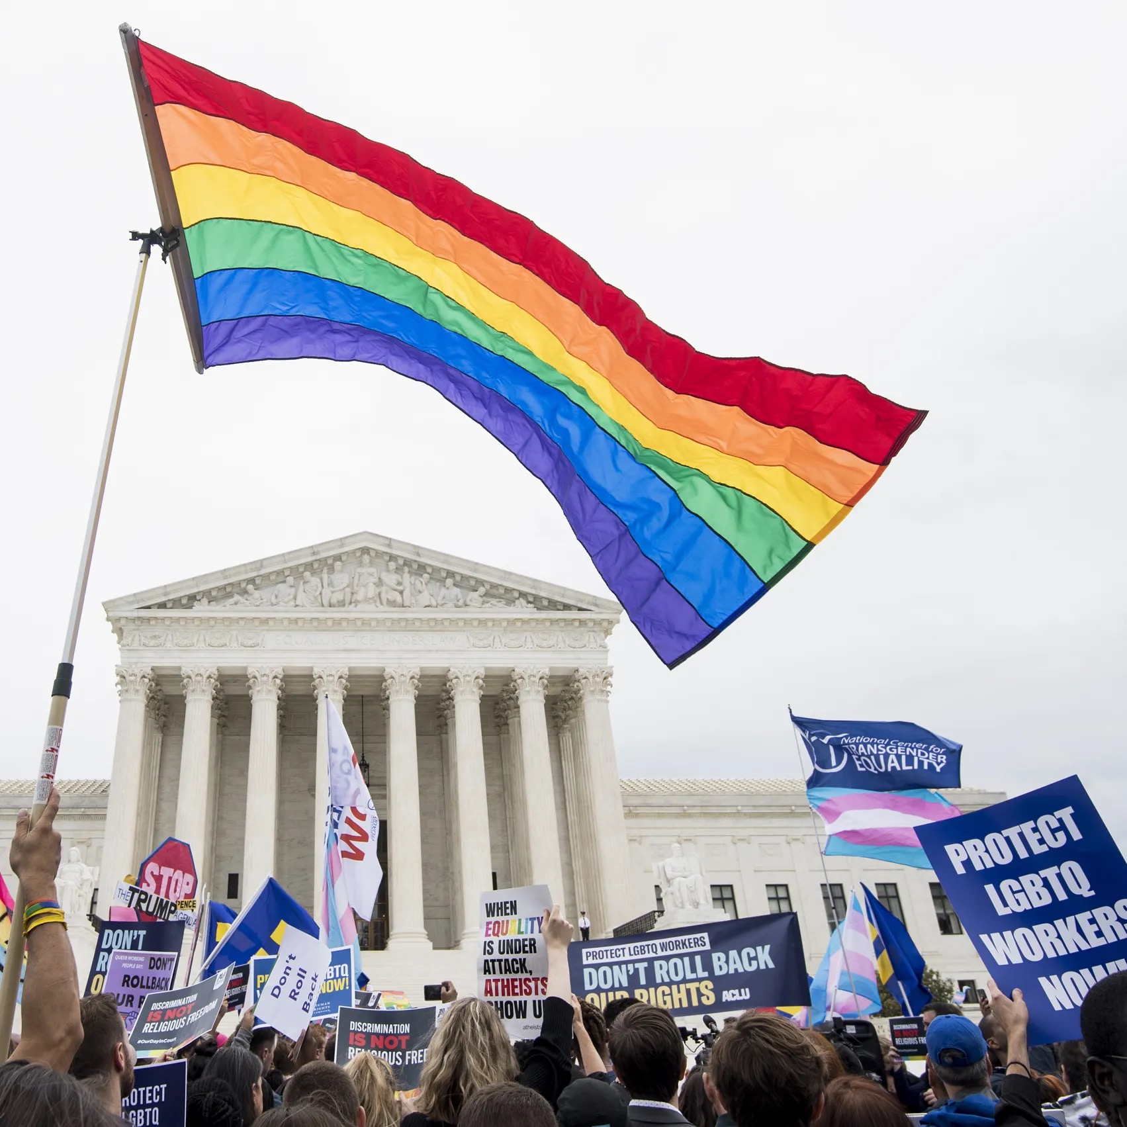

Slide 9
The Step of “Others”
v. 9 & 11 and looking down

Slide 10
The Step of “Others”
v. 9 & 11 and looking down
…With it we bless our Lord and Father, and with it we curse men, who have been made in the likeness of God; from the same mouth come both blessing and cursing. My brethren, these things ought not to be this way.
- James 3:9-10

Slide 11
The Step of “Others”
v. 9 & 11 and looking down
Others have faces
Avoiding the Pit: Don’t forget your roots (Titus 3:1-5)

Slide 12
The Pit of “Others”
“I just can’t believe people do_________ and it really makes me angry when I see _______.”

Slide 13
The Step of “Big Sins”
?
?
murder
anger
?
?
theft
greed
adultery
lust
?
?
homosexuality
coveting
?
pride
drunkenness
?
?
speech
sexual immorality
?
grudges

Slide 14
The Step of “Big Sins”
James 4:17, Psalm 19:12, 130:3
ALL sin puts ALL outside of God
Avoiding the Pit: Don’t forget why Jesus died (1 John 2:2, Isaiah 59:15-17)

Slide 15
The Step of “Big Sins”
“…and He Himself is the atoning sacrifice for our sins, and not only for our sins but also for the whole world.”
- 1 John 2:2
James 4:17, Psalm 19:12, 130:3
ALL sin puts ALL outside of God
Avoiding the Pit: Don’t forget why Jesus died (1 John 2:2, Isaiah 59:15-17)

Slide 16
The Step of “Big Sins”
James 4:17, Psalm 19:12, 130:3
ALL sin puts ALL outside of God
Avoiding the Pit: Don’t forget why Jesus died (1 John 2:2, Isaiah 59:15-17)

Slide 17
The Step of Ritual
Fasting, Tithing, and Marriage
Oh how I love your law!
Avoiding the Pit: Don’t forget pure religion (James 1:26-27)

Slide 18
Avoiding the Pitfall of
Self Righteousness
Don’t forget:
Your roots
Why Jesus died
Pure religion
HUMILITY

